Slide 1

Bike Share Case Study
Linear Regression

Slide 2

Problem Statement
A bike-sharing system is a service in which bikes are made available for shared use to individuals on a short term basis for a price or free. Many bike share systems allow people to borrow a bike from a "dock" which is usually computer-controlled wherein the user enters the payment information, and the system unlocks it. This bike can then be returned to another dock belonging to the same system.
They have contracted a consulting company to understand the factors on which the demand for these shared bikes depends. Specifically, they want to understand the factors affecting the demand for these shared bikes in the American market. The company wants to know:
Which variables are significant in predicting the demand for shared bikes.
How well those variables describe the bike demands
Based on various meteorological surveys and people's styles, the service provider firm has gathered a large dataset on daily bike demands across the American market based on some factors.

Slide 3
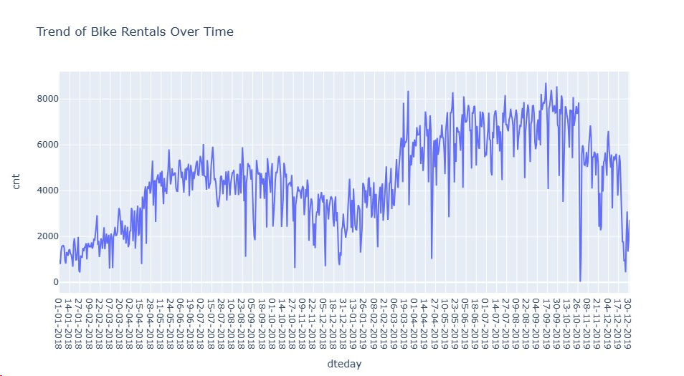
EDA

Slide 4
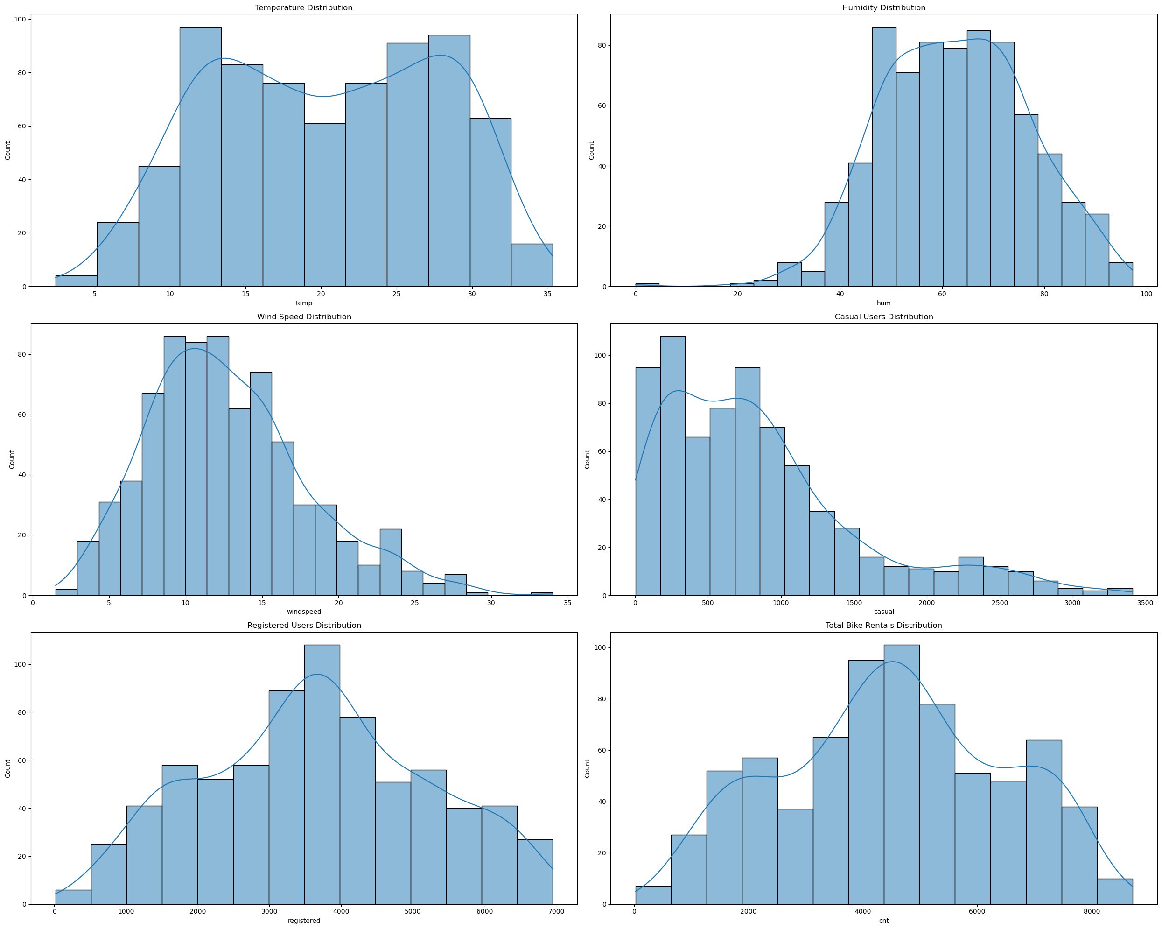
Univariate

Slide 5
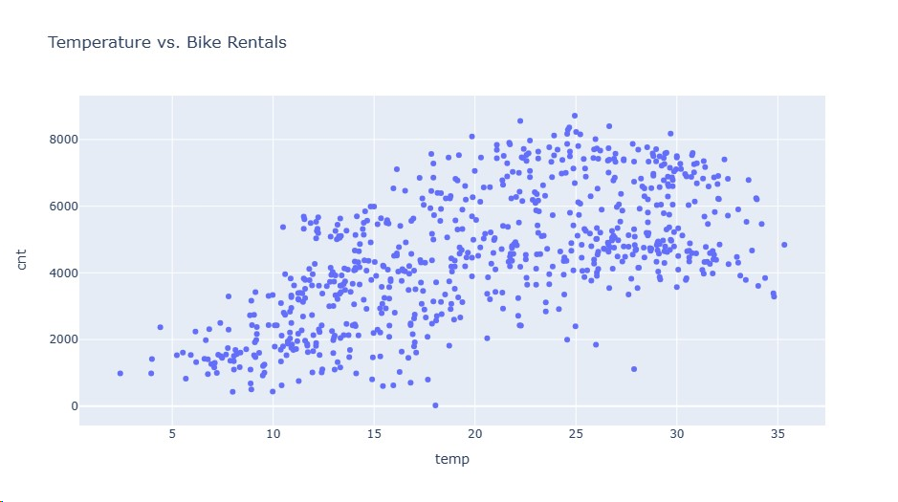
Bivariate

Slide 6
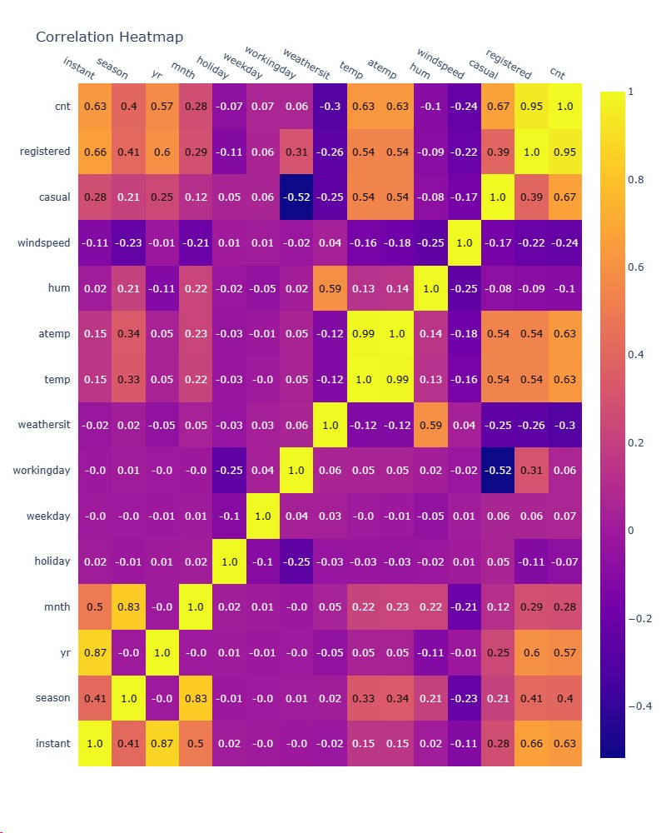
Multivariate

Slide 7
Categorical Variables
season: Has 4 unique values, representing the four seasons.
yr: Has 2 unique values (0 and 1), which likely correspond to two different years.
mnth: Has values from 1 to 12, representing the months.
holiday: Binary variable indicating whether the day is a holiday.
weekday: Has values from 0 to 6, representing the days of the week.
workingday: Binary variable indicating whether it's a working day.
weathersit: Has 3 unique values, representing different weather situations.

Slide 8
Data Preprocessing
1
Since Instant is a record Index setting it as a Index.
data.set_index('instant', inplace=True)
data = data.drop(columns=['casual', 'registered', 'dteday'])
2
Drop 'casual', 'registered',dteday columns
3
Conversion based on Labels
season_mapping = {1: 'Spring', 2: 'Summer', 3: 'Fall', 4: 'Winter’}
weathersit_mapping = {1: 'Clear', 2: 'Misty', 3: 'Light Snow/Rain', 4: 'Heavy Snow/Rain’}
data['season'] = data['season'].map(season_mapping)
data['weathersit'] = data['weathersit'].map(weathersit_mapping)
# Apply One-Hot Encoding
data = pd.get_dummies(data, columns=['season', 'weathersit'], drop_first=True,dtype=np.uint8)
4
Dropping atemp to solve Multicollinearity issue
data_cleaned = data_cleaned.drop(['atemp'], axis=1)

Slide 9
Train and Test Split
X=data_cleaned.drop(["cnt"],axis=1)
y=data_cleaned["cnt"]
from sklearn.model_selection import train_test_split
X_train,X_test,y_train,y_test=train_test_split(X,y,test_size=0.2,random_state=100)
Standardisation
#z=x-xmean/sigma
X_train=(X_train-X_train.mean())/X_train.std()
X_test =(X_test-X_test.mean())/X_test.std()
Feature Selection
from sklearn.feature_selection import RFE
from sklearn.linear_model import LinearRegression
estimator=LinearRegression()
selector=RFE(estimator,n_features_to_select=13)
selector=selector.fit(X_train,y_train)
selector.support_

Slide 10
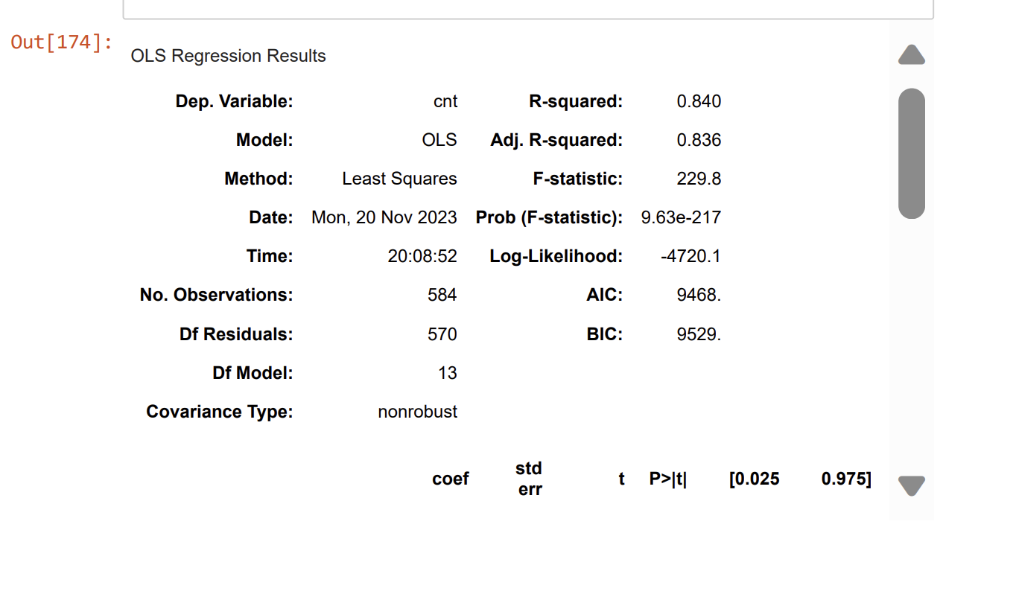
Add constant and build model
1
import statsmodels.api as sm
X_train_sm=sm.add_constant(X_train)#X_train_sm["const"]=1
X_test_sm=sm.add_constant(X_test)
model1=sm.OLS(y_train,X_train_sm)
res1=model1.fit()
res1.summary()
2
Note : R2 Value obtained is 0.84, It means model is significant
3

Slide 11
VIF calculation
from statsmodels.stats.outliers_influence import variance_inflation_factor
vif_data=pd.DataFrame()
vif_data["Feature"]=X_train.columns
vif_data["VIF"]=[variance_inflation_factor(X_train.values,i) \
for i in range(len(X_train.columns))]
vif_data
 | Feature | VIF
0 | yr | 1.033464
1 | mnth | 3.450078
2 | holiday | 1.082243
3 | weekday | 1.022350
4 | workingday | 1.067836
5 | temp | 3.455507
6 | hum | 1.927480
7 | windspeed | 1.191047
8 | season_Spring | 5.704841
9 | season_Summer | 2.501956
10 | season_Winter | 3.511936
11 | weathersit_Light Snow/Rain | 1.244444
12 | weathersit_Misty | 1.599589

Slide 12
R2 calculation for Test Data
y_pred_test = res1.predict(X_test_sm)
# Calculate the total sum of squares (TSS) and residual sum of squares (RSS) for the test data
TSS_test = np.sum((y_test - np.mean(y_test)) ** 2)
RSS_test = np.sum((y_test - y_pred_test) ** 2)
# Calculate R² for the test data
r_squared_test = 1 - (RSS_test / TSS_test)
0.767111132775213

Slide 13
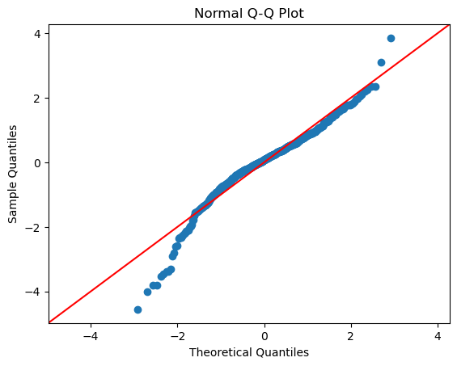
Model Evaluation using Q-Q Plot
If the data were perfectly normally distributed, the points would lie exactly on the red line. However, the deviations from the line at both ends suggest that the data distribution has lighter tails than the normal distribution on the lower end and heavier tails on the upper end. This could indicate potential outliers or that the data are not perfectly normally distributed.

Slide 14


More questions about Project?
Visit the GitHUB

